Slide 1
Argument:
An Introduction
Chapter 1

Slide 2

What is Argument?
Argument is not
a fight or quarrel.
Notes:
The word argument may have negative connotations, but it need not remain a negative concept. Rather, argument may be seen as problem solving—a way to clarify issues, assess the alternatives, and choose the best solution among many. As the text notes, argument is “a creative and productive activity that engages us at high levels of inquiry and critical thinking” (Ramage, Bean, & Johnson, 2016, pp. 2-3).

Slide 3
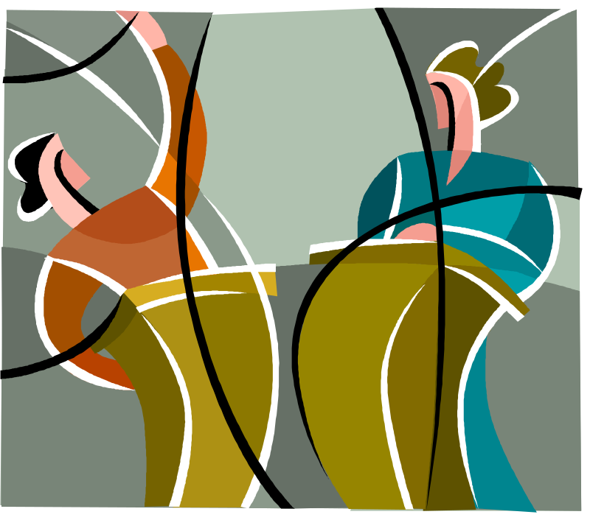
What is Argument?
Argument is not
a pro-con debate.
Notes:
While argument can be a pro-con debate, the debate format is designed to create winners and losers rather than to encourage “a process of cooperative inquiry…. [A]rgument entails a desire for truth; it aims to find the best solution to complex problems” (p. 3).

Slide 4
What is Argument?
Arguments can be
explicit or implicit
  Figure 1.1, p. 4
  Figure 1.2, p. 6
Notes:
As Ramage, Bean, and Johnson note, “An explicit argument directly states its controversial claim and supports it with reasons and evidence” (p. 3). The claim in an implicit argument is implied; within a range of possibilities, much may be left open to interpretation. Implicit arguments depend heavily on an understanding of the audience’s values, beliefs, and concerns. But both explicit and implicit arguments attempt to persuade their audience “toward a certain point of view” (p. 3).

Slide 5
For class discussion
See Discussion Assignments, Week 1, Number 1 to analyze pp. 6-7 in the text.
Notes:
Follow the instructions for the discussion, not the ones in the text.
Note that first posting for this discussion is by 11:59 p.m., Tuesday, Week 1.

Slide 6
The Defining Features of Argument
Argument requires
justification of its claims.
1. two or more
conflicting assertions
2. attempt to resolve
the conflict through reasoning
Notes:
As you consider justifying your claims, for example, think about “family values” and assumptions. Perhaps you value eating at least one meal a day around the table. Another family may value eating at least one meal a day around a movie. You assert that eating around the table helps the family communicate, touch base, talk about schedules. Another family asserts that they achieve all of those ends through their technological means of communication, so watching a movie together helps them relax, do an activity together that they all enjoy, and contribute to the knowledge they hold in common.
What assumptions do we make about the value of higher education? You may have had to make assertions about your desire to continue your education to a family member or friend who does not have the same assumptions about the value of higher education as you do. You may have had to counter your family member’s or friend’s assertions that higher education is a waste of time and money.
How about the need for professional training for ministers? about the role of women in contemporary society? about how marriages work?
You assert this, but I assert that. Thoughtful argument attempts to resolve these conflicts through discussion and reasoning.

Slide 7
The Defining Features of Argument
Argument is both
a process and a product.
Notes:
The process that is argument is the way that “two or more parties seek the best solution to a question or problem” (p. 10).
The product that is argument is “any person’s contribution to the conversation at a given moment” (p. 10). These contributions become longer as the argument becomes more formal, moving from the informality of my taking my turn in the conversation to the formality of my writing a doctoral dissertation.
Each product has its own conventions, standards, and expectations. A cell phone text message, for example, may say, “LOL.” Its counterpart in a fiction book may say, “She momentarily considered what her beau proposed and then laughed aloud in joyful expectation of the days to come.” (I didn’t say it was a good fiction book.) Both of these products provide essentially the same information; each follows its genre’s expectations for spelling, length, word usage, punctuation, and completeness. The writer’s or speaker’s challenge is to adapt to each genre (type of product) appropriately.

Slide 8
The Defining Features of Argument
Argument combines
truth seeking and persuasion.
Notes:
As Figure 1.5 on p. 11 of the text indicates, arguments may be placed on a continuum from truth seeking (exploring all sides of an issue) to persuasion (outright propaganda). While one may take issue with “outright propaganda,” each of the other entries has a legitimate place, each depending on the writer’s purpose, means of communication, and audience. As the authors note, “[A]ll along the continuum, writers attempt both to seek truth and to persuade, but not necessarily with equal balance” (p. 12).

